Slide 1
Adv. Digital Image Processing
Image Segmentation

Slide 2
Image Segmentation
Group similar components (such as, pixels in an image, image frames in a video)
Applications: Finding tumors, veins, etc. in medical images, finding targets in satellite/aerial images, finding people in surveillance images, summarizing video, etc.

Slide 3
Image Segmentation
Segmentation algorithms are based on one of two basic properties of gray-scale values:
Discontinuity
Partition an image based on abrupt changes in gray-scale levels.
Detection of isolated points, lines, and edges in an image.
Similarity
Thresholding, region growing, and region splitting/merging.

Slide 4



Thresholding
Segmentation into two classes/groups
Foreground (Objects)
Background

Slide 5
Thresholding
Objects & Background
Global Thresholding
Local/Adaptive Thresholding

Slide 6
Global Thresholding
Single threshold value for entire image
Fixed ?
Automatic
Intensity histogram

Slide 7
Global Thresholding
Single threshold value for entire image
Fixed ?
Automatic
Intensity histogram

Slide 8
Global Thresholding
Estimate an initial T
Segment Image using T: Two groups of pixels G1 and G2
Compute average gray values m1 and m2 of two groups
Compute new threshold value T=1/2(m1+m2)
Repeat steps 2 to 4 until: abs(T_{i} – T_{i-1})<epsilon

Slide 9
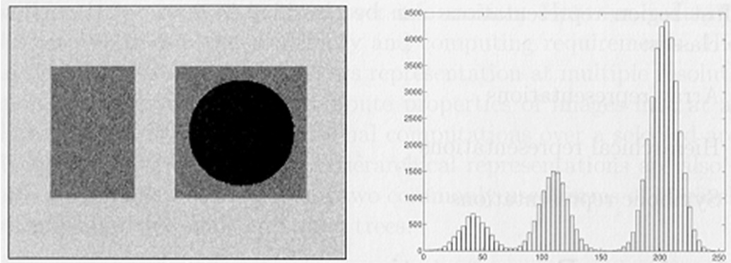
Global Thresholding
Multilevel thresholding

Slide 10

Thresholding
Non-uniform illumination:

Slide 11
Global Thresholding

Slide 12
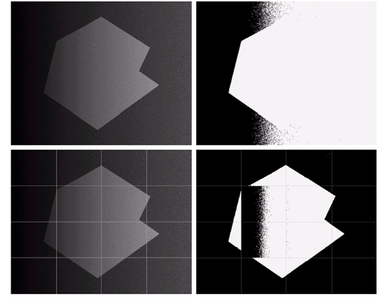
Adaptive Thresholding

Slide 13
Adaptive Thresholding
Threshold: function of neighboring pixels

Slide 14
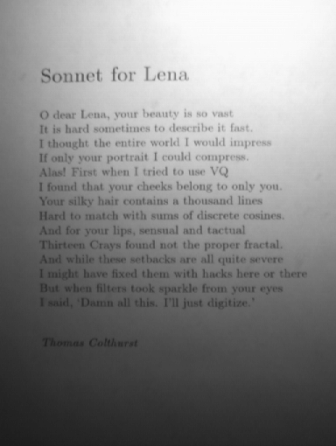
Adaptive Thresholding
Original Image
Global Thresholding

Slide 15
Adaptive Thresholding
T=mean, neighborhood=7x7
T=mean-Const., neighborhood=7x7

Slide 16
Adaptive Thresholding
Niblack Algorithm
Neighborhood size???

Slide 17
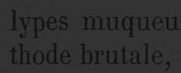
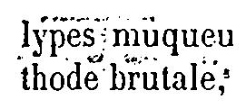


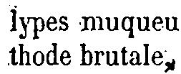
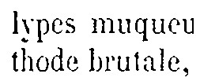
Document Binarization
Local Thresholding – Examples
Original
Niblack
Sauvola
Wolf
Feng
NICK

Slide 18

Document Binarization
DIBCO 2009*
35 Research groups
43 Algorithms
*ICDAR 2009 Document Image Binarization Contest (DIBCO 2009)

Slide 19
Document Binarization
Results: DIBCO 2009

Slide 20
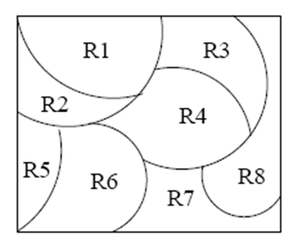
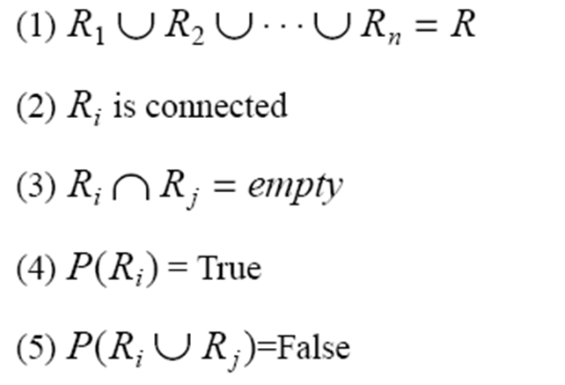
Region-Based Segmentation
Divide the image into regions
R₁,R₂,…,R_{N}
Following properties must hold:
(For adjacent regions)

Slide 21
Region-Based Segmentation
Region Growing
Region growing: groups pixels or subregions into larger regions.
Pixel aggregation: starts with a set of “seed” points and from these grows regions by appending to each seed points those neighboring pixels that have similar properties (such as gray level).
Choose the seed pixel(s).
Check the neighboring pixels and add them to the region if they are similar to the seed
Repeat step 2 for each of the newly added pixels; stop if no more pixels can be added
Predicate: for example abs(z_{j} - seed) < Epsilon

Slide 22
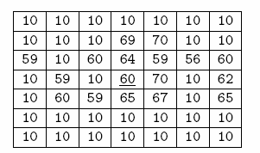
Region-Based Segmentation
Example

Slide 23
Region-Based Segmentation
Region Splitting
Region Growing: Starts from a set of seed points.
Region Splitting: Starts with the whole image as a single region and subdivide the regions that do not satisfy a condition.
Image = One Region R
Select a predicate P (gray values etc.)
Successively divide each region into smaller and smaller quadrant regions so that:

Slide 24
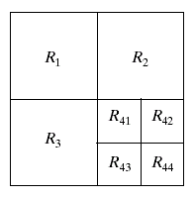
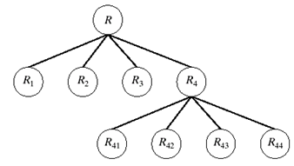
Region-Based Segmentation
Region Splitting
Problem?
Adjacent regions could be same
Solution?
Allow Merge

Slide 25
Region-Based Segmentation
Region Merging
Region merging is the opposite of region splitting.
Merge adjacent regions R_{i} and R_{j} for which:
Region Splitting/Merging
Stop when no further split or merge is possible

Slide 26
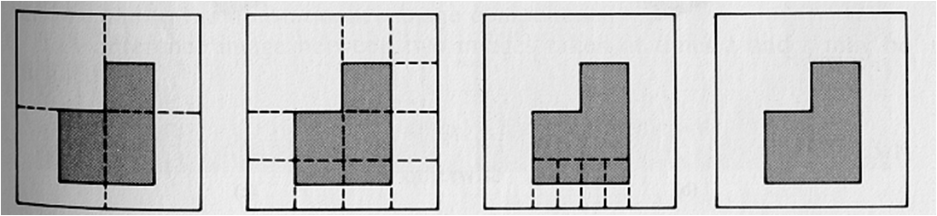
Region-Based Segmentation
Example
Split into four disjointed quadrants any region R_{i} where P(R_{i})=False
Merge any adjacent regions R_{j} and R_{k} for which P(R_{j} U R_{k})=True
Stop when no further merging or splitting is possible

Slide 27
K-Means Clustering
Chose the number (K) of clusters and randomly select the centroids of each cluster.
For each data point:
Calculate the distance from the data point to each cluster.
Assign the data point to the closest cluster.
Recompute the centroid of each cluster.
Repeat steps 2 and 3 until there is no further change in the assignment of data points (or in the centroids).

Slide 28
K-Means Clustering

Slide 29
K-Means Clustering

Slide 30
K-Means Clustering

Slide 31
K-Means Clustering

Slide 32
K-Means Clustering

Slide 33
K-Means Clustering

Slide 34
K-Means Clustering

Slide 35
K-Means Clustering

Slide 36
K-Means Clustering

Slide 37

Clustering
Example

Slide 38

Clustering
Example

Slide 39
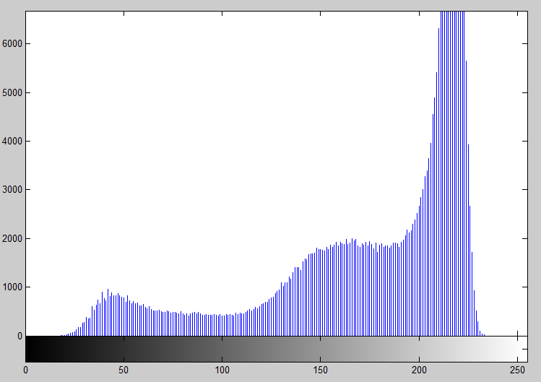
Clustering
Example

Slide 40

Clustering
Example

Slide 41
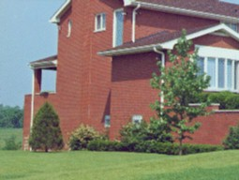
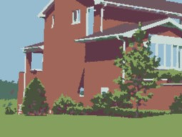
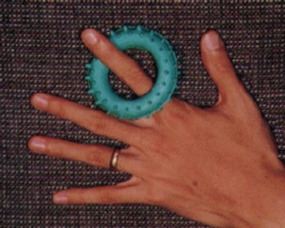

Clustering
Example
D. Comaniciu and P. Meer, Robust Analysis of Feature Spaces: Color Image Segmentation, 1997.

Slide 42
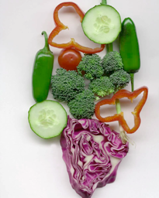
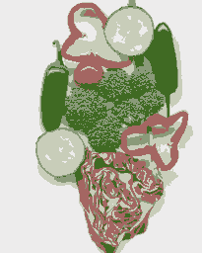
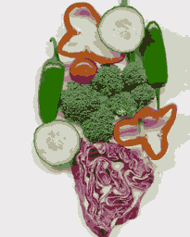
K-Means Clustering
Example
Original
K=5
K=11

Slide 43
Image Segmentation (Recall)
Segmentation algorithms are based on one of two basic properties of gray-scale values:
Discontinuity
Partition an image based on abrupt changes in gray-scale levels.
Detection of isolated points, lines, and edges in an image.
Similarity
Thresholding, region growing, and region splitting/merging.

Slide 44
Overview
Point Detection
Line Detection
Edge Detection
4/25/2017
Image Segmentation
44

Slide 45
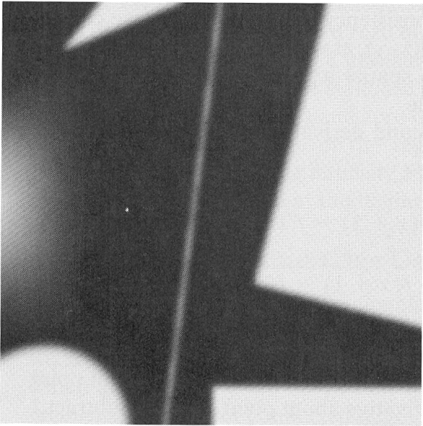
Recall – Chapter 3
Example
This image contains various objects a line and an isolated noise point
We consider a horizontal line passing through the isolated point
4/25/2017
Image Segmentation
45

Slide 46
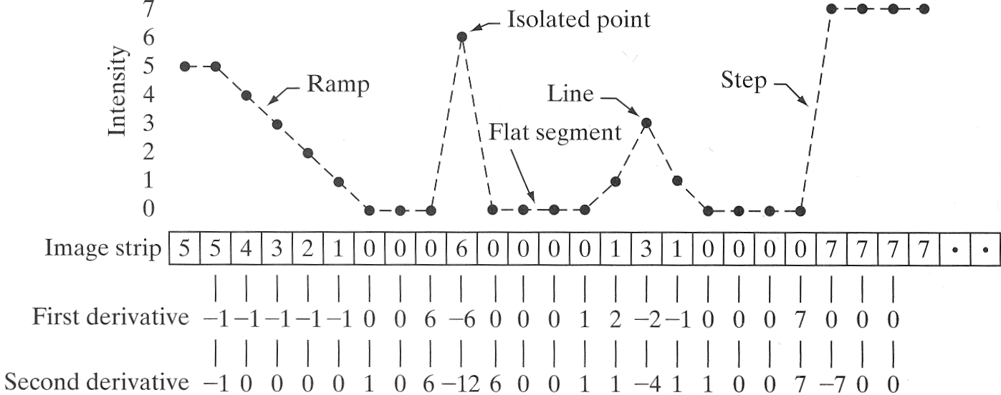
Recall – Chapter 3
We consider the properties of the first and the second order differences of the intensity as we traverse the line from left to right.
4/25/2017
Image Segmentation
46

Slide 47
Recall – Key Points
First order differences generally produce thicker edges in an image (see the ramp).
Second order differences have a stronger response to fine detail, such as isolated points and thin lines (see isolated point and the line).
The second order difference produces a double response as it transitions into and out of an edge (see ramp and step).
The sign of the second order difference can determine if the transition is from light to dark, or vice-versa (see ramp and step).
4/25/2017
Image Segmentation
47

Slide 48
Detection of Isolated Points
Isolated Point
Gray level – Different from neighboring pixels
Second Derivative – Laplacian (Recall)
Implementation – Spatial filters

Slide 49
Detection of Isolated Points
We say that a point has been detected at the location (x,y), if the absolute value of the response is above a threshold T
If the detected points are labelled 1 and all others are labelled 0, we can visualise the results of point detection by a binary image g(x,y)
4/25/2017
Image Segmentation
49

Slide 50
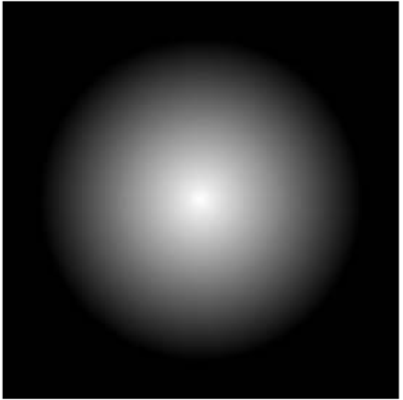

Detection of Isolated Points
Example
Original image with a nearly invisible isolated dark point in the dark gray area
Binary image showing the detected point
4/25/2017
Image Segmentation
50

Slide 51
Line Detection
A line is an edge segment in which the intensity of the background on either side is either much higher or much lower than the intensity of the line pixels
Assumption: Lines are thin w.r.t. size of detector
Laplacian Mask – Line Detection
4/25/2017
Image Segmentation
51

Slide 52
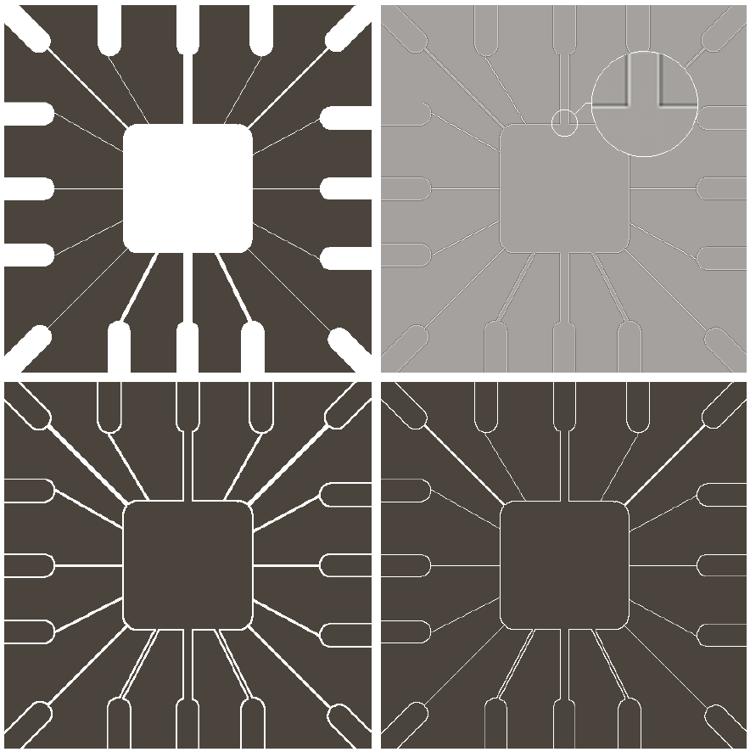
Line Detection
4/25/2017
Image Segmentation
52

Slide 53
Line Detection
Anisotropic masks
The previous mask is isotropic – Does not have preference for any particular direction
Anisotropic masks can be used to detect lines in specified directions
Horizontal
-45°
Vertical
+ 45°
4/25/2017
Image Segmentation
53

Slide 54
Line Detection
Let R1, R2, R3, R4 be the responses of the previous four masks centred on (x,y)
The pixel (x,y) is said to be more likely associated with the direction of the mask with the highest response in absolute values
For example, if
we say that (x,y) is more likely associated with the horizontal direction
4/25/2017
54
Image Segmentation

Slide 55



Line Detection
To detect lines in a specified direction, we run the corresponding mask through the image and threshold the absolute values of the result
Example
Original image
Response of the -45° line detection mask
4/25/2017
55
Image Segmentation

Slide 56
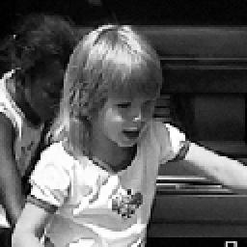



Edge Detection
Edge – Area of significant change in intensity
Edge Detection – Locating areas with strong intensity contrast
Local changes of intensity can be detected using differences of neighbouring pixels
4/25/2017
Image Segmentation
56

Slide 57

Types of Edges
Variation of intensity/gray level
Step Edge
Ramp Edge
Roof Edge
Step Edge
Ramp Edge
Roof Edge
4/25/2017
Image Segmentation
57

Slide 58
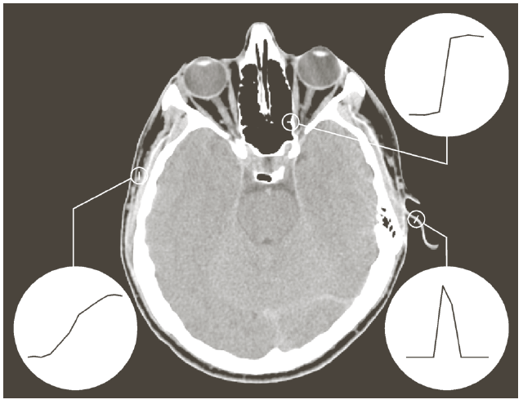
Types of Edges
Example
Deviations from ideal models
Step
Roof
Ramp
4/25/2017
Image Segmentation
58

Slide 59
Types of Edges
Example
4/25/2017
Image Segmentation
59

Slide 60
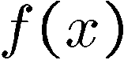
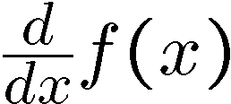
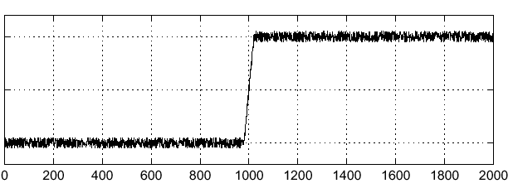
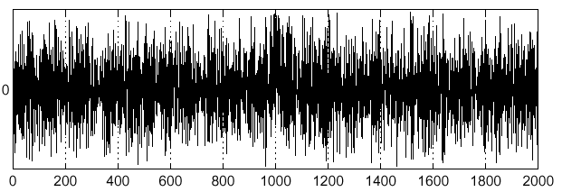
Edge Detection – Effects of Noise
Consider a single row or column of the image
Plotting intensity as a function of position gives a signal
Where is the edge??
4/25/2017
Image Segmentation
60

Slide 61


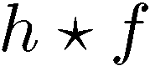
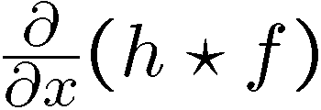
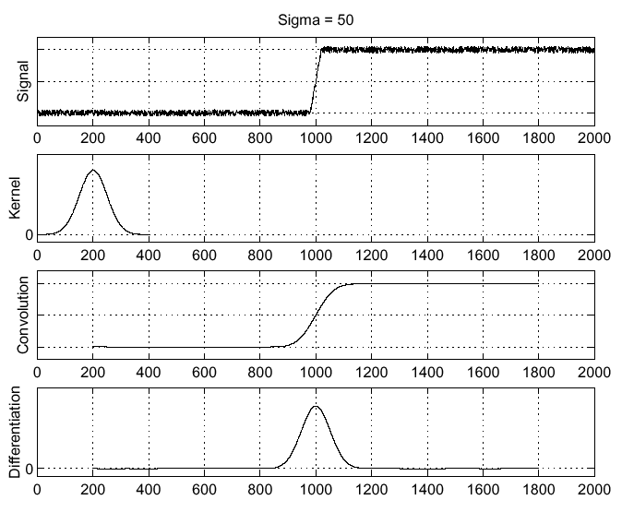
Effects of Noise - Solution
Smoothing
4/25/2017
Image Segmentation
61

Slide 62
Edge Detection
Key Steps
Image Smoothing – Noise Reduction
Detection of Edge Points
Edge Localization
4/25/2017
Image Segmentation
62

Slide 63
Detecting Edge Points
First Derivative / Gradient Methods
Roberts Operator
Prewitt Operator
Sobel Operator
Second Derivative
Laplacian
Laplacian of Gaussian
Optimal Edge Detection
Canny Edge Detector
4/25/2017
Image Segmentation
63

Slide 64
Gradient
For a continuous two dimensional function Gradient is defined as
4/25/2017
Image Segmentation
64

Slide 65
Gradient
Approximation of Gradient for a discrete two dimensional function
Gradient Magnitude: ‘Strength’ of edge
Gradient Direction: Points in the direction of most rapid change in intensity

Slide 66
Gradient
Implementation: Convolution Masks
-1
1
-1 | 1
Diagonal Direction: Roberts cross-gradient operators
0 | -1
1 | 0
-1 | 0
0 | 1
2x2 Masks: Differences are computed at interpolated points
3x3 Masks: Symmetric about the central pixel
4/25/2017
Image Segmentation
66

Slide 67
Gradient
Prewitt Operators
-1 | -1 | -1
0 | 0 | 0
1 | 1 | 1
-1 | 0 | 1
-1 | 0 | 1
-1 | 0 | 1
Sobel Operators
-1 | -2 | -1
0 | 0 | 0
1 | 2 | 1
-1 | 0 | 1
-2 | 0 | 2
-1 | 0 | 1
4/25/2017
Image Segmentation
67

Slide 68

Edge Detection
Example
Original Image
Horizontal Edges
Vertical Edges
Horizontal + Vertical
4/25/2017
Image Segmentation
68

Slide 69
Edge Detection
Example
Original Image
Horizontal Edges
Vertical Edges
Gradient Magnitude
4/25/2017
Image Segmentation
69

Slide 70
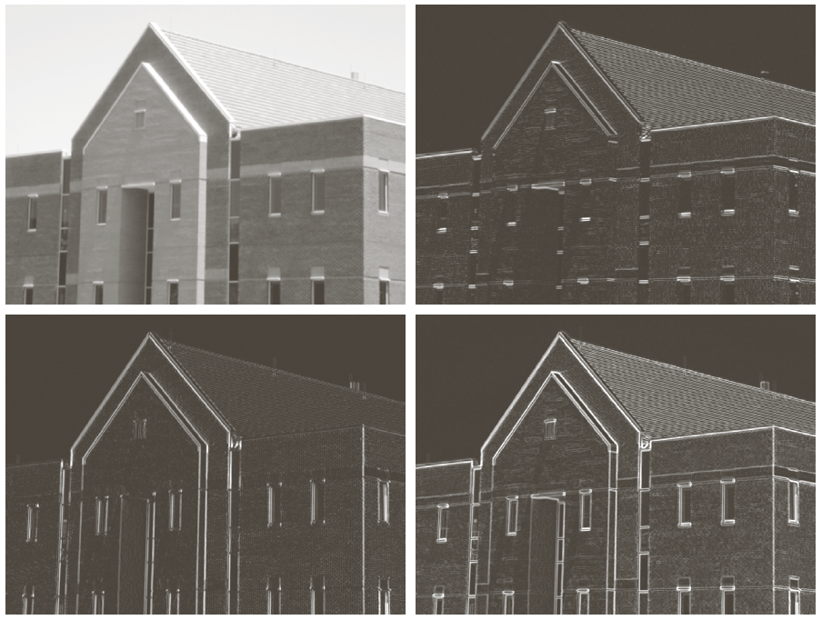
Edge Detection with Smoothing
Example
4/25/2017
Image Segmentation
70

Slide 71
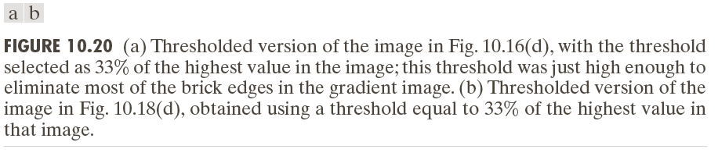
Edge Detection with Thresholding
Example
4/25/2017
Image Segmentation
71

Slide 72
References
Chapter # 10, DIP by Gonzalez & Woods
Lecture slides by:
Cornelia Fermüller
Sumit Tandon
Ioannis Ivrissimtzis
Longin Jan Latecki
George Bebis
Bahadir K. Gunturk
http://homepages.inf.ed.ac.uk/rbf/HIPR2/
4/25/2017
Image Segmentation
72

